Slide 1
Quantum Computing
Intro
Hook
Explore
Explain
Apply
Share
Evaluate
Expand

Slide 2
What is quantum computing?
Intro
Hook
Explore
Explain
Apply
Share
Evaluate
Expand
1- To understand what quantum computing is and how it works, we first need to take a step back and look at classical computing.
2- Quantum computing is based on the principles of quantum mechanics, which describe the behavior of matter and energy at a microscopic scale.
3- Unlike classical computing, which uses bits to process and store information, quantum computing uses qubits, which can exist in a superposition of both 0 and 1 at the same time.

Slide 3

Why learn quantum computing?
Intro
Hook
Explore
Explain
Apply
Share
Evaluate
Expand
Several exciting applications already known:
1- Factoring large composite numbers, breaking RSA encryption (Shor’s algorithm, 1994).
2- Search an unordered list in O(n squared) time(Grover's algorithm, 1996).

Slide 4
Learning objectives
Intro
Hook
Explore
Explain
Apply
Share
Evaluate
Expand
1- Representing computation with basic linear algebra(vectors and matrices).
2- Qbits, superposition and quantum logic gates.
3- A communication problem where a quantum computer beats a classical computer.

Slide 5
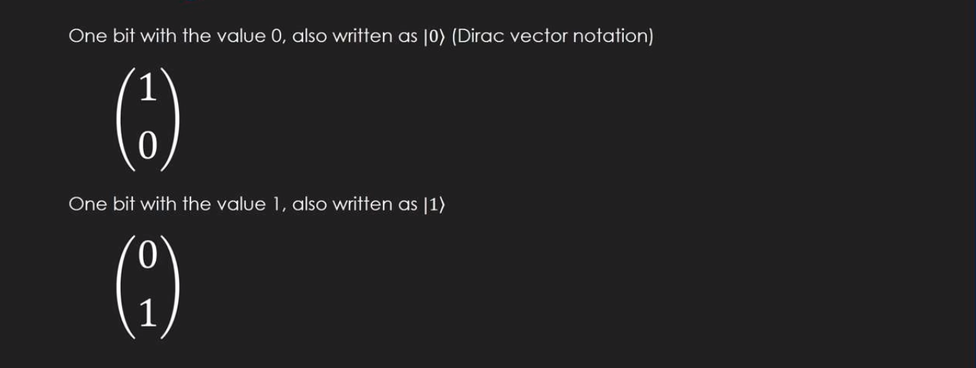
Representing computation with basic linear algebra
Intro
Hook
Explore
Explain
Apply
Share
Evaluate
Expand

Slide 6
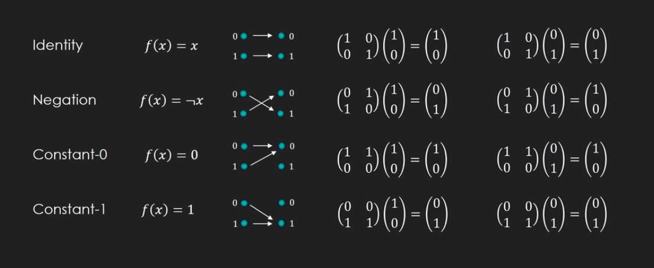
Operations on one classical bit (cbit)
Intro
Hook
Explore
Explain
Apply
Share
Evaluate
Expand

Slide 7
Reversible computing
Intro
Hook
Explore
Explain
Apply
Share
Evaluate
Expand

Slide 8
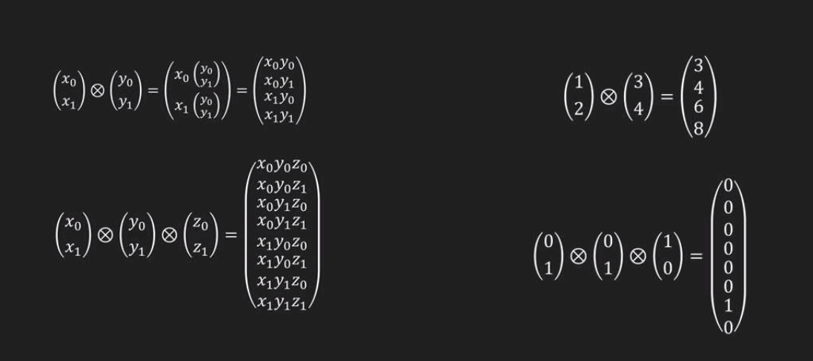
Tensor product:
Intro
Hook
Explore
Explain
Apply
Share
Evaluate
Expand

Slide 9
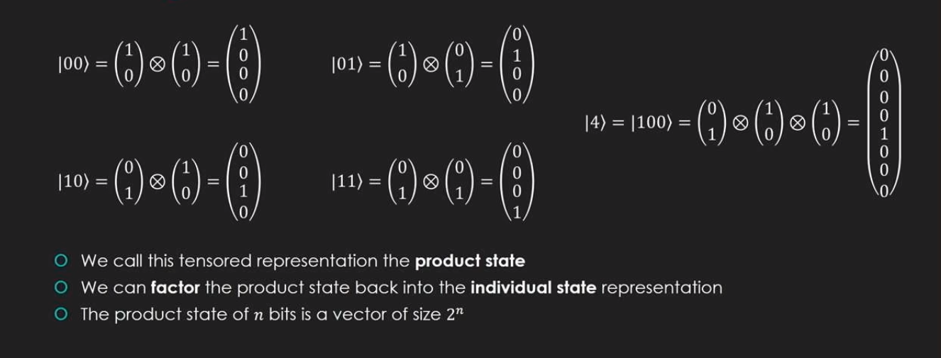
Representing multiple cbits
Intro
Hook
Explore
Explain
Apply
Share
Evaluate
Expand

Slide 10
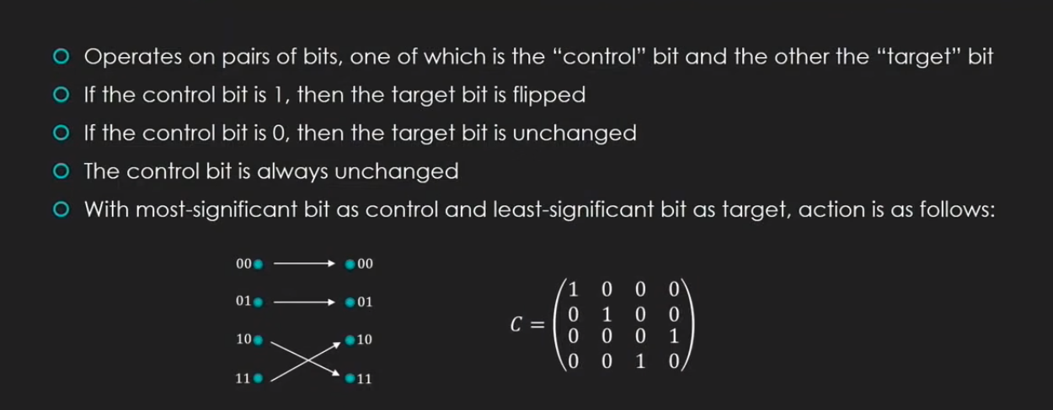
CNOT gate
Intro
Hook
Explore
Explain
Apply
Share
Evaluate
Expand

Slide 11
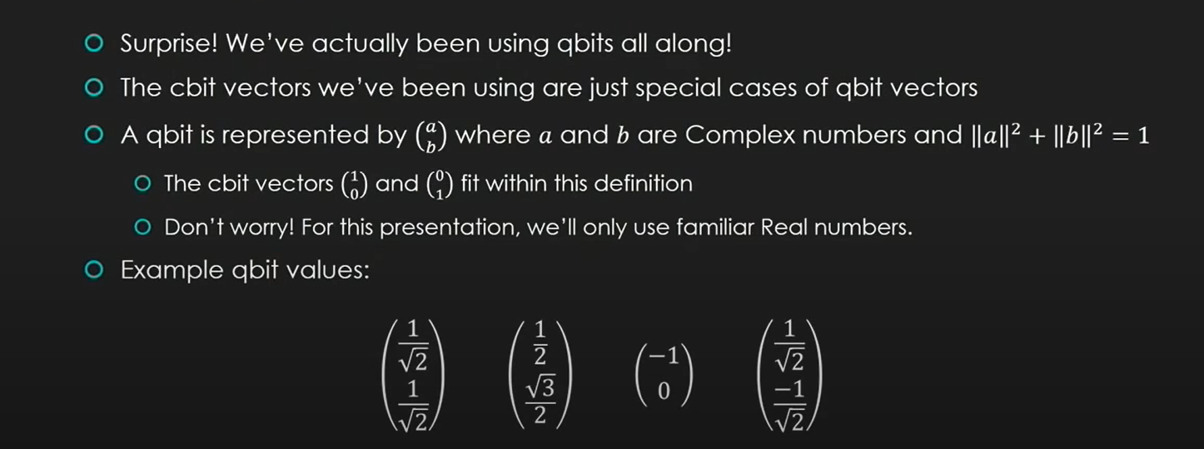
َQbit
Intro
Hook
Explore
Explain
Apply
Share
Evaluate
Expand

Slide 12
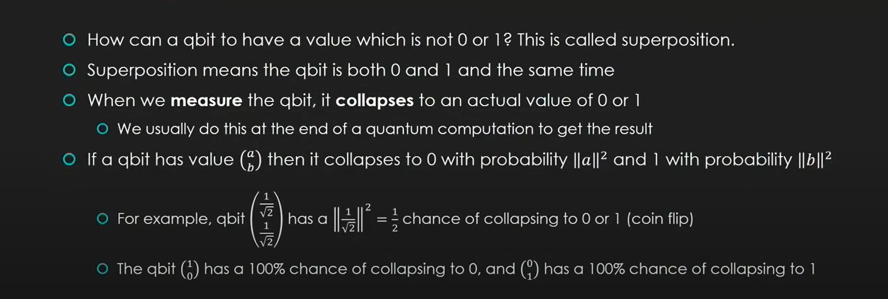
Superposition
Intro
Hook
Explore
Explain
Apply
Share
Evaluate
Expand

Slide 13
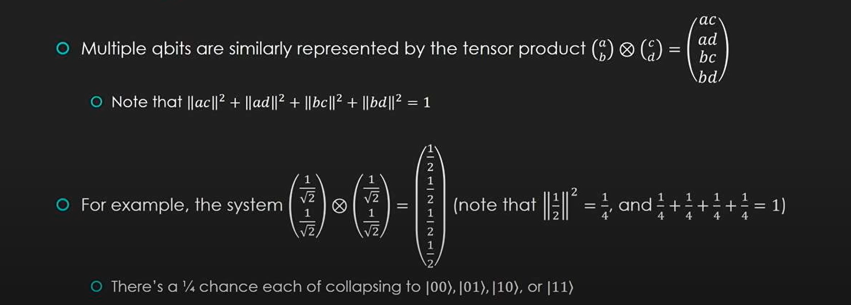
Superposition
Intro
Hook
Explore
Explain
Apply
Share
Evaluate
Expand

Slide 14
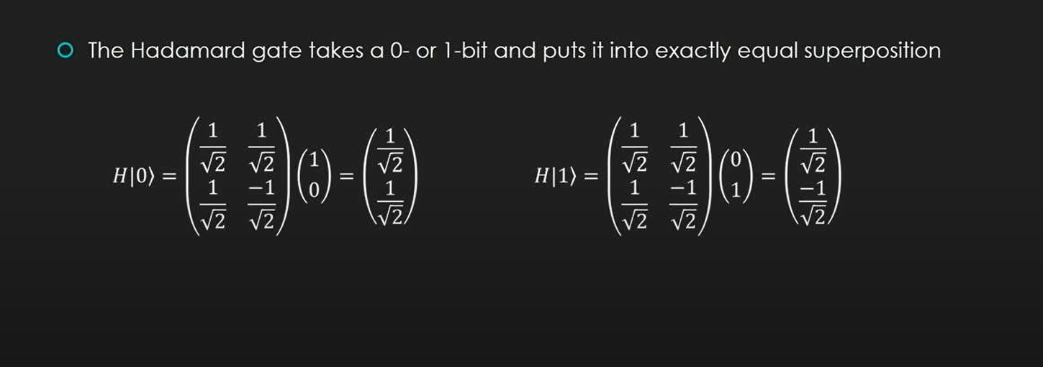
Hadamard gate
Intro
Hook
Explore
Explain
Apply
Share
Evaluate
Expand

